Slide 1
Sio Silica Corporation’s
Environment Act Project Proposal
- Presentation at the Public Hearing -
Holländer, H.M.; Woodbury, A.D.
PorousTec Ltd.
07.03.2023

Slide 2
Dr. Hartmut Holländer, P.Eng. (MB)
>20 years of experience across Canada and internationally
2010-2012: regulatory authority (State Authority of Mining, Energy and Geology - Landesamt für Bergbau, Energie und Geologie, LBEG) Hanover, Germany
State-of-the-art of science and technology: authorized expert for the nuclear waste repository Asse II and research mine Gorleben, Germany (80%)
State-of-the-art (industry standard): numerical models in environmental proposals, i.e. groundwater withdrawal by waterworks and industry (20%)
2013-2022: University of Manitoba, Department of Civil Engineering, Groundwater Engineering (research assistant, Associate Professor, Professor)
2020- : PorousTec Ltd, Winnipeg, MB, Director
2022- : Ingenieurgesellschaft Dr. Schmidt mbH, Stade, Germany, CEO

Slide 3
Dr. Allan Woodbury, P.Eng. (MB, BC)
Lifetime Professor Emeritus, Department of Civil Engineering, University of Manitoba
>40 years of experience across Canada and internationally
Considerable experience in service to Manitoba and in the area of question
Provided consultation to more than 16 governments and organizations across North America, including AECL and the Center for Nuclear Waste Regulatory Analyses in Texas

Slide 4
Outline
Hydrogeological Investigations
Site Conceptual Model
Numerical Groundwater Modeling
Geochemistry

Slide 5
Overarching Concerns
What is a sustainable amount of water to develop from an aquifer?
Avoid dewatering an aquifer; avoid mining groundwater (discharge from all sources exceeds recharge)
Avoid excessive drawdowns, which cause well interference with other users
Groundwater quality: inducing water of poorer quality into water supply wells
Subsidence, deformation, sink hole collapse; preserving aquifer integrity
Preventing cross contamination between aquifers
Sealing wells and aquifers from surface contamination

Slide 6
Area of Interest
Study area from Sandilands to Red River (~80 km)
Area of interest (red) in the centre of the study area
~80 km
Red River
~40 km
Start of Carbonate aquifer and Winnipeg Shale
Sandilands recharge area
Start of Winnipeg sandstone aquifer

Slide 7
Which data are needed to study such a problem?
Landscape features/boundaries
River, creeks, lakes
Recharge areas (mainly Sandilands, Birdshill area)
Geology (GWDrill database, additional boreholes)
Which formations need to be considered?
Layer thickness
Hydraulic properties of formations
Hydraulic conductivity
Storativity
Regional groundwater table maps for specific dates
generally: steady-state conditions for a certain period (e.g., last 10 years or periods when pumping was minimal)
Wells
Location
Pumping rates

Slide 8
Hydrogeological Investigations (i)
Key question: Was the investigation program adequate?
Size of study area: ~3200 km² – basin scale
How homogenous (constant in space) is each formation?
Aquifers: hydraulic properties in horizontal direction
Aquitards/aquicludes: hydraulic properties in vertical direction
Based on experience and literature reviews, aquifers are not homogeneous.
Testing
1 aquifer test: industry standard to derive regional data (~1-2 km around borehole)
5 slug tests: local data (~2 m around borehole) – not suitable for regional investigations

Slide 9
Hydrogeological Investigations (ii)
Key question: Was the investigation program adequate?
1 aquifer test = assumption is that the aquifers in the project area are homogenous
Aquifer test covers about 3 km² and the project is about 3,200 km²
It cannot be expected that such a large area is (completely) homogenous
Other studies (e.g., extensive study by Kennedy and Woodbury, 2002) show heterogenous aquifer properties in the study area

Slide 10
Hydrogeological Investigations (iii)
Key question: Was the pump test adequately performed and evaluated?
Aquifer test: step test followed by constant rate
Step Test: unusual intervals of (1) 412 to (2) 402 USGPM, to (3) 421 USGPM,
Constant rate: (4) 372 USGPM
3 days for pumping (not all observation wells showed steady-state drawdown)
followed by 4 days of observing the recovery
(1)
(2)
(3)
(4)

Slide 11
Hydrogeological Investigations (iv)
Key question: Was the pump test adequately performed and evaluated?
All evaluation methods assume confined conditions (= no drawdown should be observed in carbonate aquifer)
Figs. 3-2 & 3-3 show drawdown in the carbonate aquifer (95-8 VW2: ~1.5 m)
Shale aquitard appears to exhibit leaky conditions
Why was this not evaluated using a leaky attempt (hydraulic properties of the Winnipeg Shale)?
Meaning: Is the shale leaky (pervious) or is the shale partially non-existent?
Hydrogeological Assessment Final Report (HAFR p.32): “… this information suggests the Winnipeg shale is an effective barrier to interaction between the two aquifers at this location …”

Slide 12
Hydrogeological Investigations (v)
Key question: Was the pump test adequately performed and evaluated?
(Horizontal) hydraulic property of the Winnipeg Shale
Pump test: 1.1 x 10⁻⁴ m/s
Numerical model (steady-state condition): 3.2 x 10⁻⁵ m/s
Numerical model (transient condition): altered, value not clear
Earlier studies: 5.7 x 10⁻⁵ m/s e.g., Kennedy and Woodbury, 2002 using a zone approach = heterogeneity)
How to interpret these differences?

Slide 13
Hydrogeological Investigations (vi)
What questions have not been answered at all?
There are no observations of the vertical hydraulic properties of the Winnipeg Shale in the proposed mining area
What will happen to the aquitards, the aquifers, and their material properties, after the mining activities?
Will water of poorer quality be drawn into zones that are currently good quality?

Slide 14
Conceptual Model
Which information are critical in a conceptual model?
Analysis of boreholes and create layered 3D system
Definition of the model area and description of boundaries
Information on regional flow system(s)
Choice of numerical code
Initial choice of layer parametrization (based on data and stratigraphy)
Material properties

Slide 15
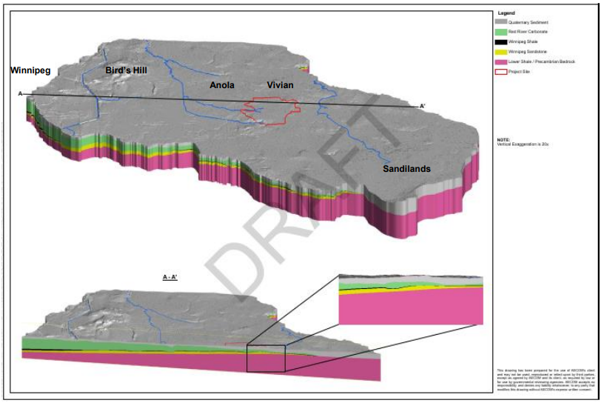
Site Conceptual Model (i)
Layers
Required: Carbonate aquifer (green), Winnipeg shale (black), Winnipeg sandstone formation (yellow)
Useful: quaternary sediments (grey)
additional: Precambrian bedrock (red, no impact on results)

Slide 16
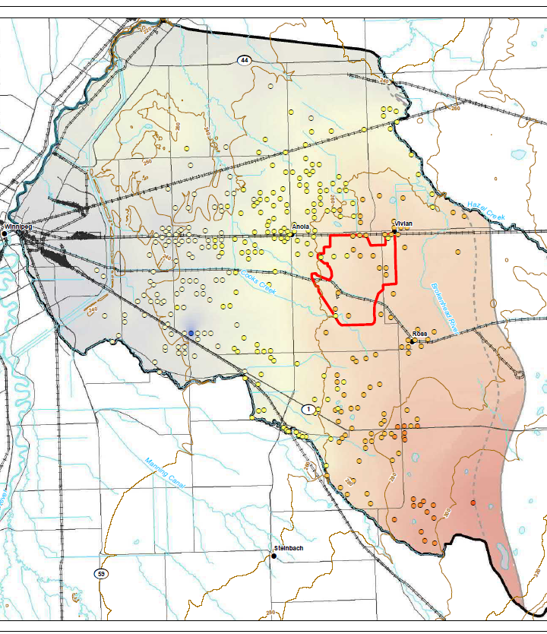
Site Conceptual Model (ii)
Regional groundwater table maps
Industry standard: Need to be created for a specific date (alternative: short period)
Report: all available data were used so that data from e.g., 1980 might be plotted with data from 2020
HAFR, Fig. 5-11

Slide 17
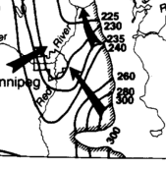
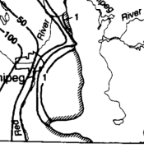
Site Conceptual Model (iii)
Boundary conditions
Brackish water exists in the Winnipeg Sandstone Formation near the Red River
Correction of measured hydraulic heads required
Betcher et al., 1995
up to 30 g/L TDS
HAFR, Fig. 5-11

Slide 18
Site Conceptual Model (iv)
Wells
Are of key interest (water supply)
Aquifer test showed already that Winnipeg Shale is leaky
Kennedy (2002) showed that nearly 500 wells are screened over both aquifers
It is not clear if any (and which) wells in the modeling domain are screened or open over several aquifers
Provincial database of wells and observation wells is generally not in the best conditions (actual data, data uncertainty, e.g., location)

Slide 19
Site Conceptual Model (v)
Choice of numerical code
FEFLOW is an adequate model to solve such problems
HAFR mentions that the movement of saline waters: “… even this small volume of water could dramatically affect local quality over time”.
Single-phase simulation does not reflect brackish groundwater in the study area
Transient simulation
Which data points are available at time t = 0 (initial conditions)?

Slide 20
Groundwater Modeling
What is a groundwater model?
Simplified, schematic representations of a part of the hydrogeological system regarding to selected properties and processes for a groundwater body
Primarily used for hydrogeologic prediction and for understanding hydrogeologic processes
Other uses:
Interpretation and synthesis of observed data
Calculating data for non-observed points (monitoring wells are expensive)
Hydraulic heads are observable, flux has to be calculated
Extrapolating/predicting future states
Calculating variants to pick the best solution

Slide 21
Numerical Groundwater Modeling (i)
Objectives (HAFR):
Evaluation of the potential for the project to impact
Groundwater quantity
Quality
Users of the surface and groundwater in the area
Missing topics:
Details on evaluation criteria
Subsidence and potential pathways opening up through the limestone aquifer

Slide 22
Numerical Groundwater Modeling (ii)
Calibration process
Calibration: adjustment of the model by variation of parameters within reasonable bounds
steady-state: groundwater measurements based on mixed dates
transient: aquifer test (total length of 7 days)
Validation: simulation of other test days or different time periods for testing of the ability to predict – not carried out
Sensitivity analysis: Identification of uncertainties by variation of the model parameter

Slide 23
Risk of Oversimplified Models
h_{sim}
Equifinality
recharge: 200 mm/a
K₁ = 8x10⁻⁵ m/s
K₂ = 2x10⁻⁴ m/s
h_{obs}
If system parameters are underrepresented, a large number of solutions is possible, e.g.,
h_{sim}
recharge: 100 mm/a
K₁ = 4x10⁻⁵ m/s
K₂ = 1x10⁻⁴ m/s
Solution: More data are required!
h_{obs}

Slide 24
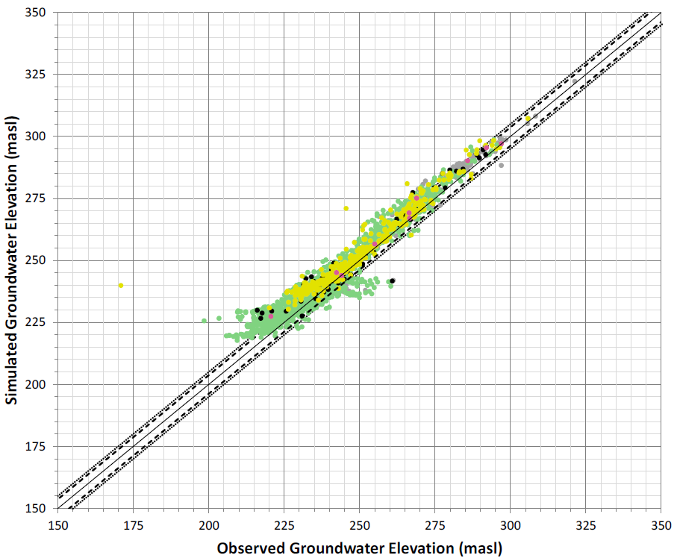
Numerical Groundwater Modeling (iii)
Calibration (steady-state)
Systematic overestimation for heads below 275 m asl
Also visible by
Model calibration not to industry standard
Model does not represent behavior of the natural groundwater flow
Model cannot be used as a predictive tool at this point

Slide 25
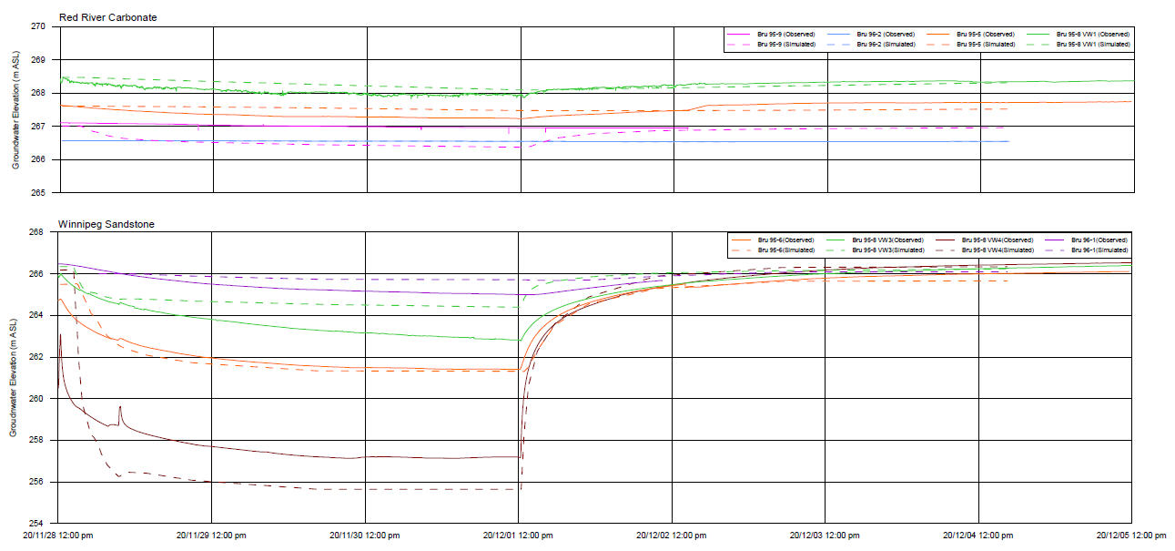
Numerical Groundwater Modeling (iv)
Calibration (transient)
Drawdown in Carbonate aquifer often lower than observed (Winnipeg Shale)
Initial drawdown often does not follow the observed data (storativity)

Slide 26
Numerical Groundwater Modeling (v)
Calibration (transient)
Hydraulic conductivity, storativity, and recharge rates were modified to match observations from the actual pump test.
Not adequate in transient calibration to recalibrate K and recharge
Statistics of actual final match were not listed
Sub-optimal fits: distances greater 300 m generally show higher observed drawdown than simulated, and the reverse is true for distances under 300 m
Calibrated values
Calibrated values were not compared (and discussed) to literature values
Anisotropy was assumed (10:1) but not evaluated in the model
Scenarios
Worst-case scenario: Failure of Winnipeg Shale was not considered in HAFR
Partial consideration in the recent work (we were not able to review it since it was presented last week only)

Slide 27
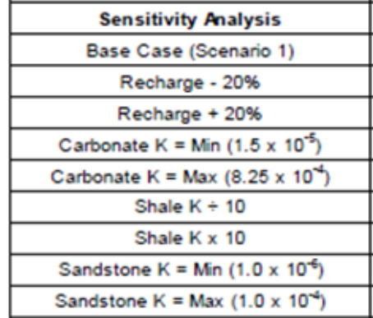
Numerical Groundwater Modeling (vi)
Sensitivity
Parameter uncertainty not defined (field test – literature values – (old) driller reports)
Limited sensitivity includes various hydraulic parameters (of the shale layer) were altered by either increasing or decreasing values by a specified amount.
Drawdowns in the Carbonate and Winnipeg Sandstone aquifers are considered to be “moderately sensitive” to changes in K of the Winnipeg Sandstone.
This comment reinforces our conclusion that the hydraulic parameters used in the numerical modeling need to be re-examined.
No boundary conditions (besides recharge) were included

Slide 28
Geochemistry (i)
Review related to acid-mine drainage
Does not include that changes to the flow, pH, and redox conditions within the aquifer due to the mining activities could result in leaching of trace metals into the aquifers (e.g., Bru121-1_36.57 to 37.00, Winnipeg Shale)
Leaching from surface water to groundwater not considered and was not compared to the guidelines
Potential pathways are sinkholes in the Upper Carbonate (e.g., near Beausejour) and brownfields

Slide 29
Geochemistry (ii)
We heard last week:
Assumption:
just 1% waste rock - expected annual production 1,360,000 m³ result in waste rock of 1,360 m³ (~2,100 tonnes)
5 years: 10,500 tonnes plus cuttings from drilling (roughly 1000 boreholes)
Sampling
Not many samples: 9 rock samples related to acid mine drainage taken
Not a single duplicate (uncertainty range?)
Unqualified grab samples taken from Winnipeg Sandstone formation
Documentation partly not adequate (e.g., what happened during storing water sample BRU 96-1 between collection and delivery to ALS?)

Slide 30
Geochemistry (iii)
Geochemical sampling before, during, and after the pumping test does not mimic reinfiltration during mining operation
Key drivers for acid mine drainage such as dissolved oxygen (DO), pH need to be stronger considered in terms of geochemical changes
Assumption: groundwater at 6˚C -> 12,45 mg/L; process might allow for 40% saturation -> DO = 5 mg/L
Slurry could be pumped 2:1 (fluid : sand, Sio says 1:1) -> 21,000 tonnes of silica sand need ~28,000 m³ of water -> total DO introduction 70 kg for each cluster
Though not all will stay in the Winnipeg Sandstone formation this has the potential to change the redox state drastically
This is not included in any evaluation

Slide 31
Geochemistry (iv)
Geochemical Modeling – Open Questions
Trace metals, which are contaminants of concern for drinking water quality, not considered
Modelling selected only low-risk scenarios and did not seek to address two major issues - a reduced water quality in general, or risk to human, aquatic, or agricultural life. Risks were not identified, e.g., by worst-case scenarios (e.g. data based on sample Bru121-1_36.57 to 37.00).
Geochemical models are not fully described, e.g., redox conditions (pe) are missing, or is pe = default = 4 used?
Potential changes to the groundwater chemistry due to the expected changes in pH and redox conditions are not included

Slide 32
Thank you very much for your attention!

Slide 33
References
Betcher, R., Grove, G., Pupp, C., 1995. Groundwater in Manitoba: hydrogeology, quality concerns, management, Environmental Sciences, Division National Hydrology Research Institute, Environment Canada.
Ferguson, G., Betcher, R.N., Grasby, S.E., 2007. Hydrogeology of the Winnipeg Formation in Manitoba, Canada. Hydrogeology Journal, 15(3): 573-587.
Kennedy, P.L., 2002. Groundwater Flow and Transport Model of the Red River/Interlake Area in Southern Manitoba, University of Manitoba, Winnipeg, MB.
Kennedy, P.L., Woodbury, A.D., 2002. Geostatistics and Bayesian updating for transmissivity estimation in a multiaquifer system in Manitoba, Canada. Ground Water, 40(3): 273-83.
Kennedy, P.L., Woodbury, A.D., 2005. Sustainability of the Bedrock Aquifer Systems in South-Central Manitoba: Implications for Large-Scale Modelling. Canadian Water Resources Journal / Revue canadienne des ressources hydriques, 30(4): 281-296.
Phipps, G., Betcher, R.N., Wang, J., 2008. Geochemical and Isotopic Characterization of a Regional Bedrock/Surficial Aquifer System, Southeastern Manitoba, GeoEdmonton ’08.
Wang, J., Betcher, R.N., Phipps, G.C., 2008. Groundwater Resource Evaluation in Southeastern Manitoba, GeoEdmonton ’08.

